Slide 1




Generative Artificial Intelligence
Paul Dubois
Info@Lèze

Slide 2
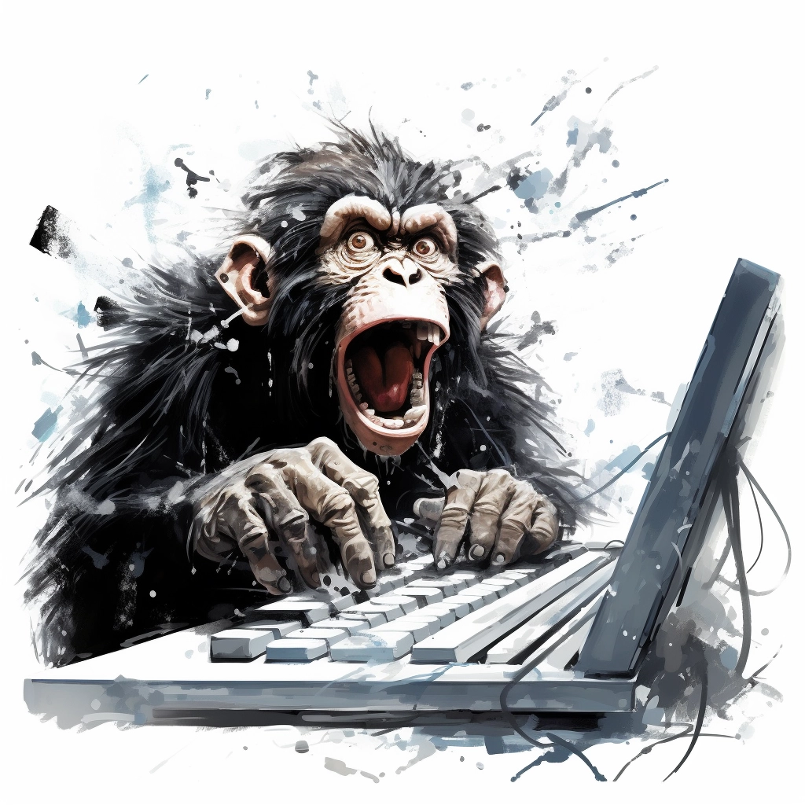
Creating new words

Slide 3
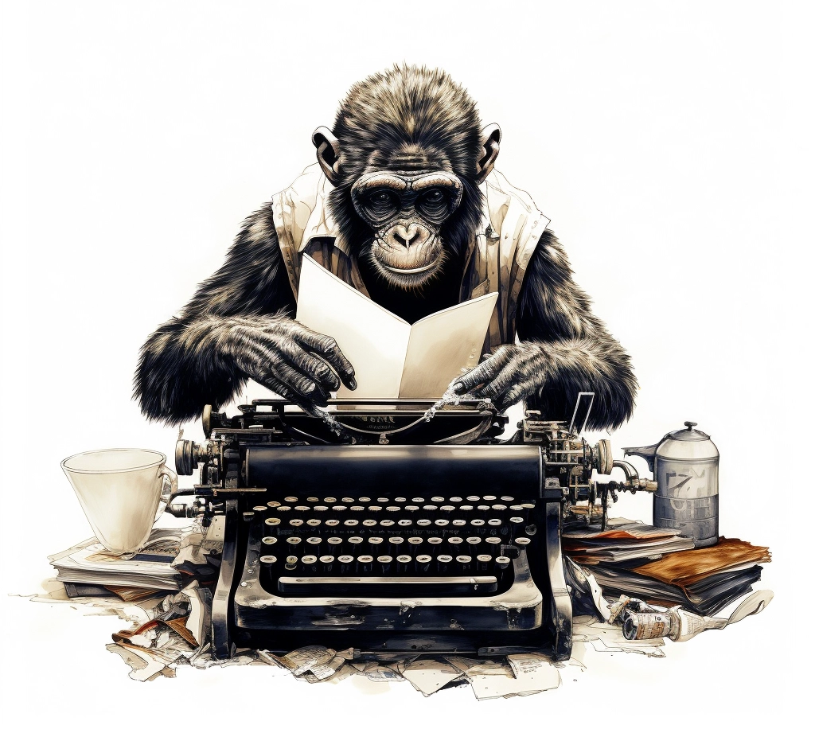
Method 1:
Randomly type on a keyboard

Slide 4
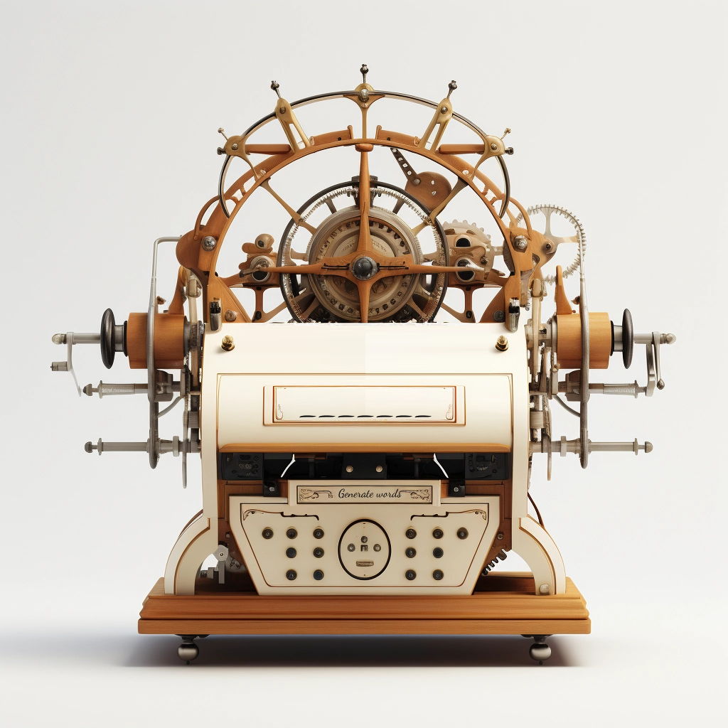
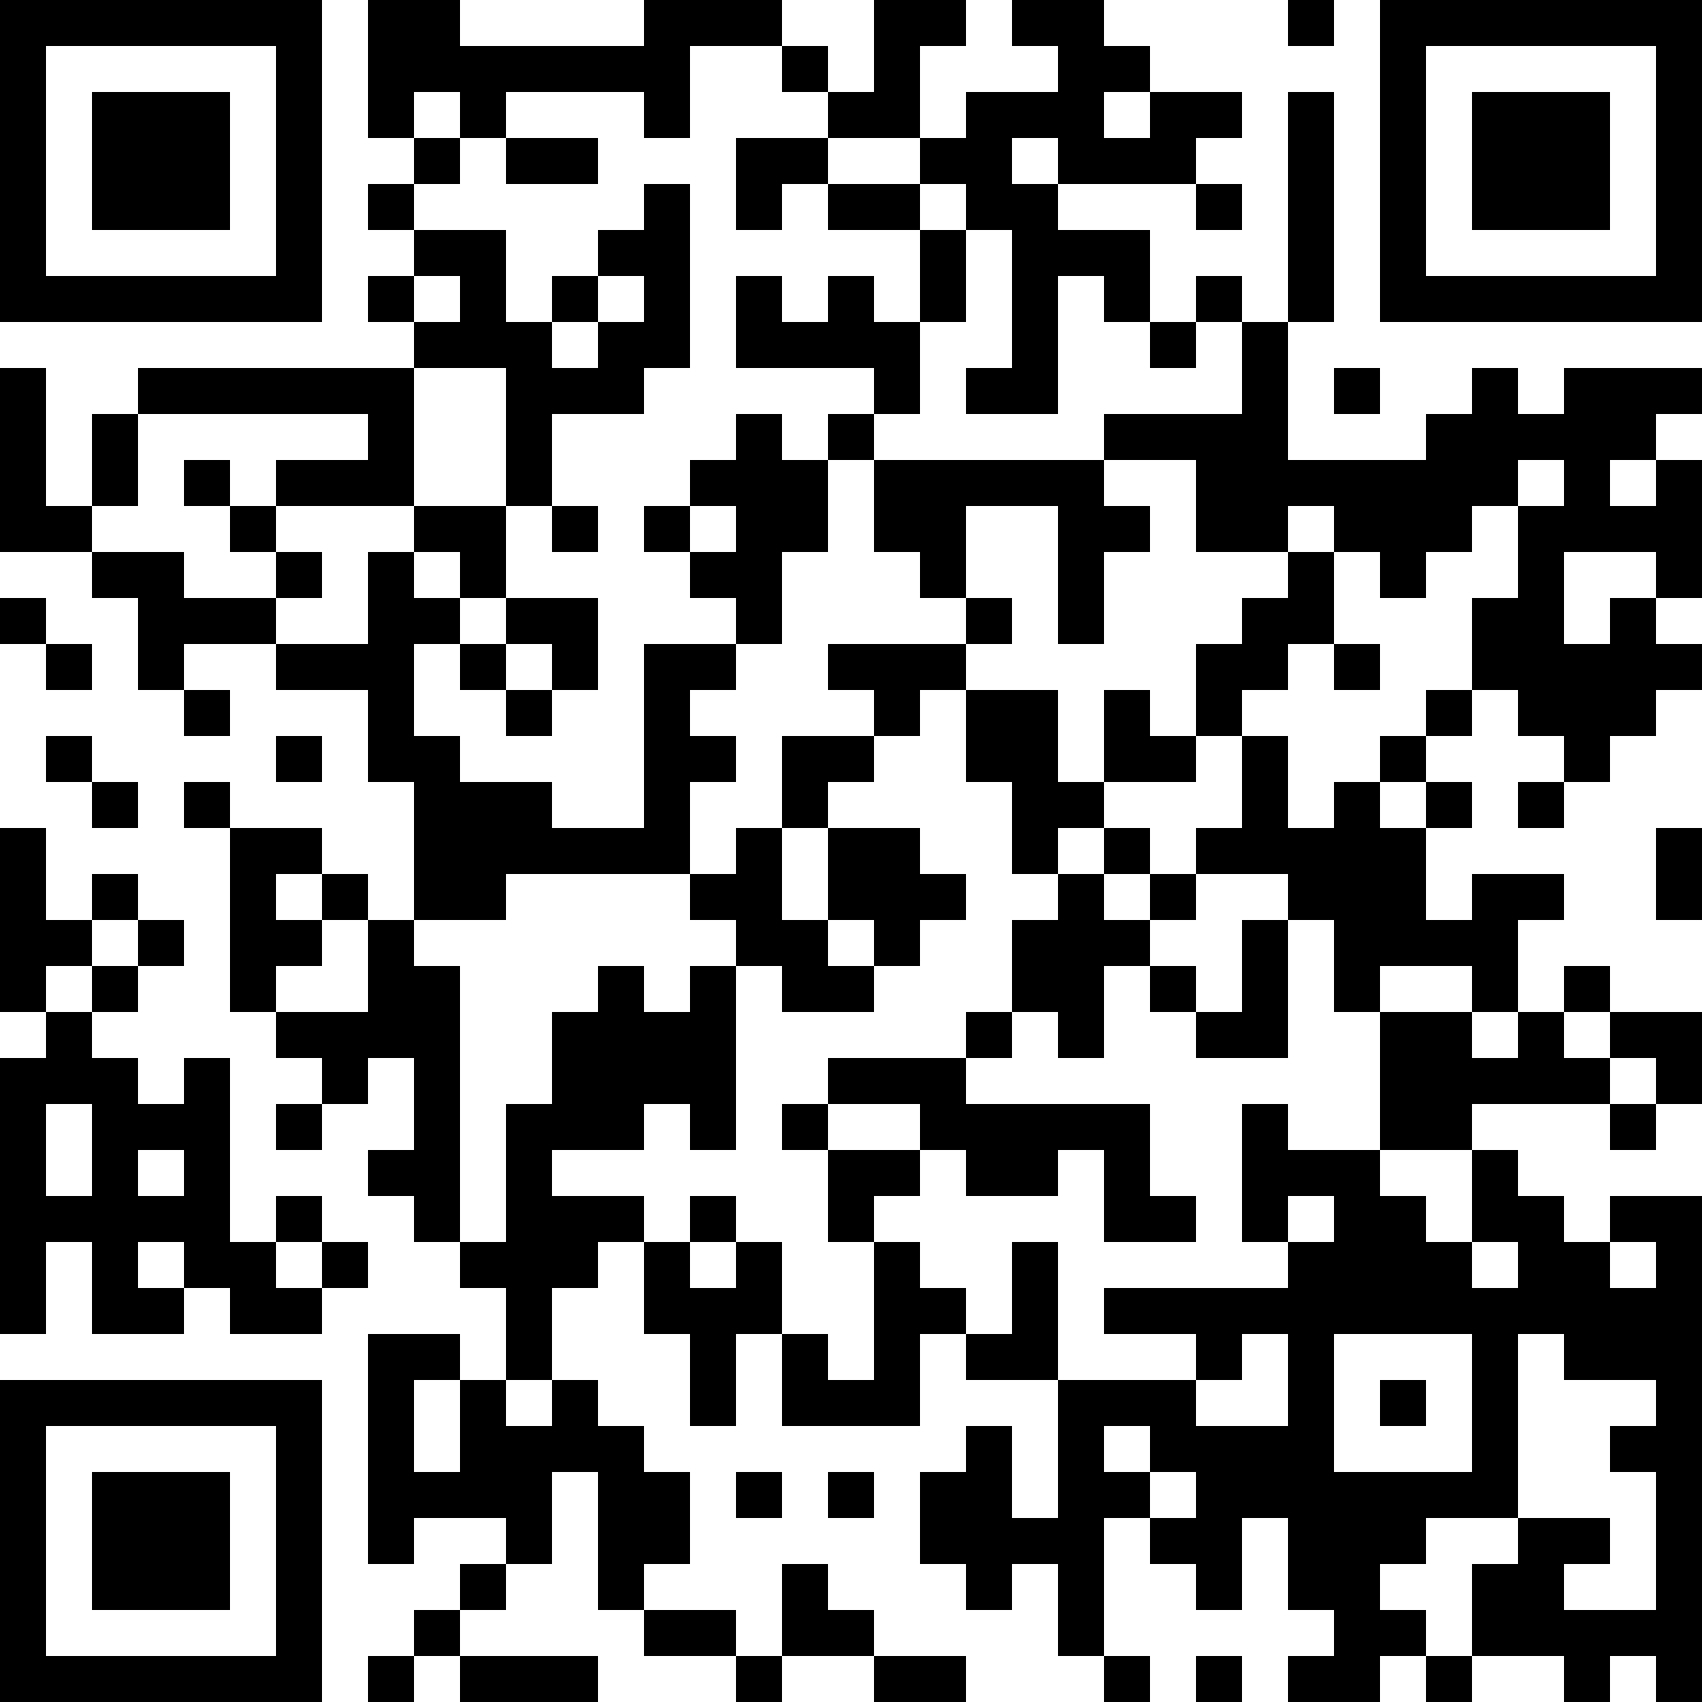
Words Generator Machine 1
https://pauldubois98.github.io/GenerativeAI/word_generator1.html

Slide 5
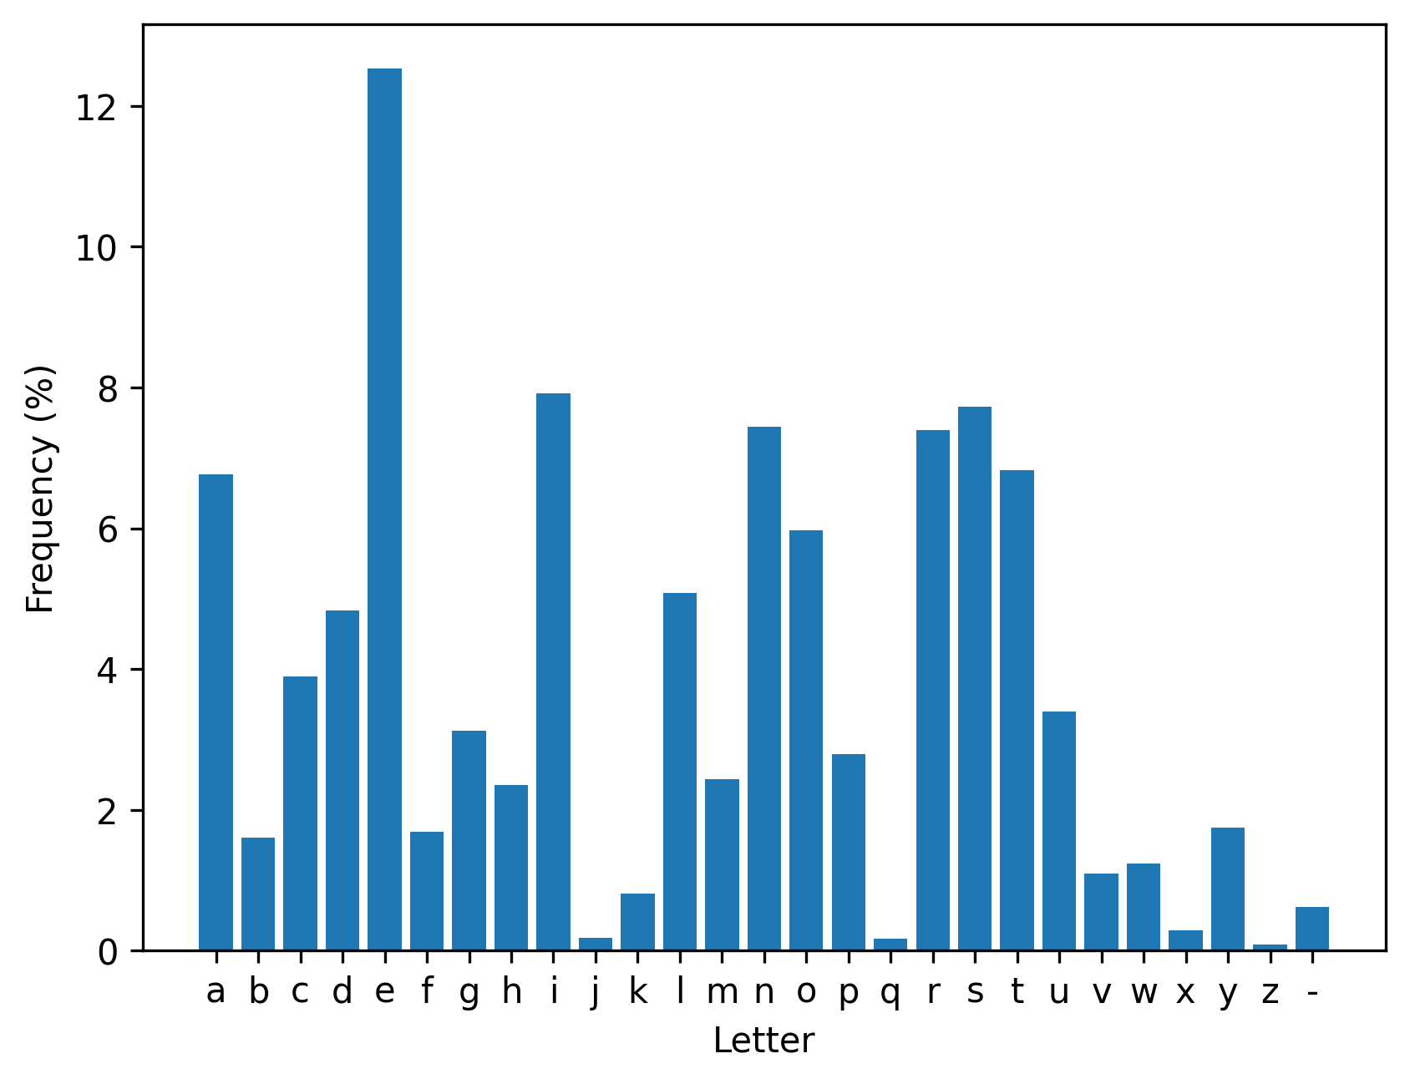
Letters usage (in dictionary)

Slide 6
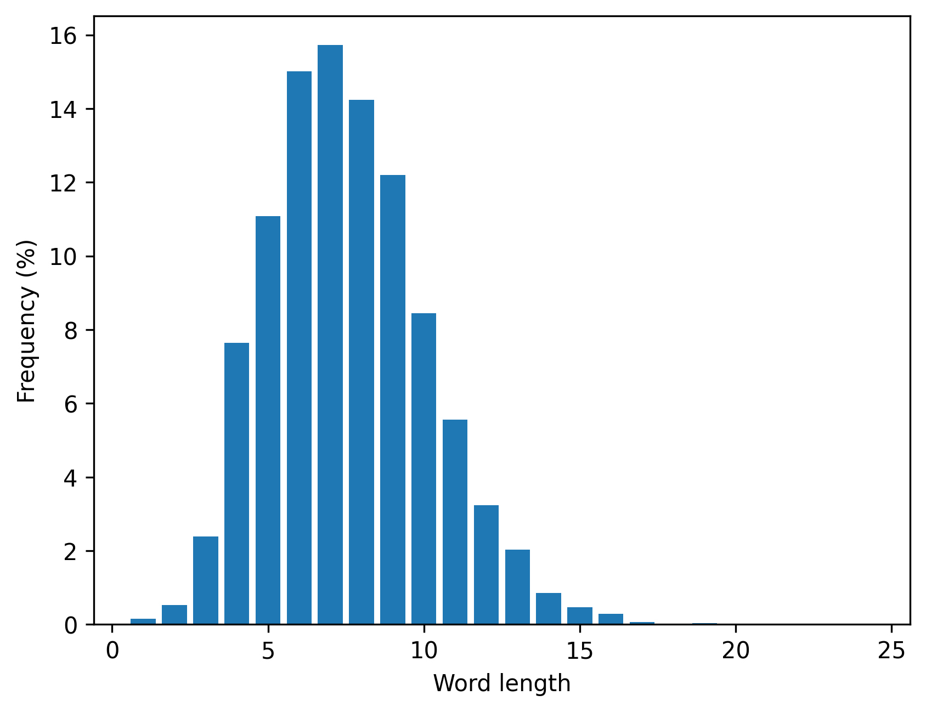
Words lengths (in dictionary)

Slide 7
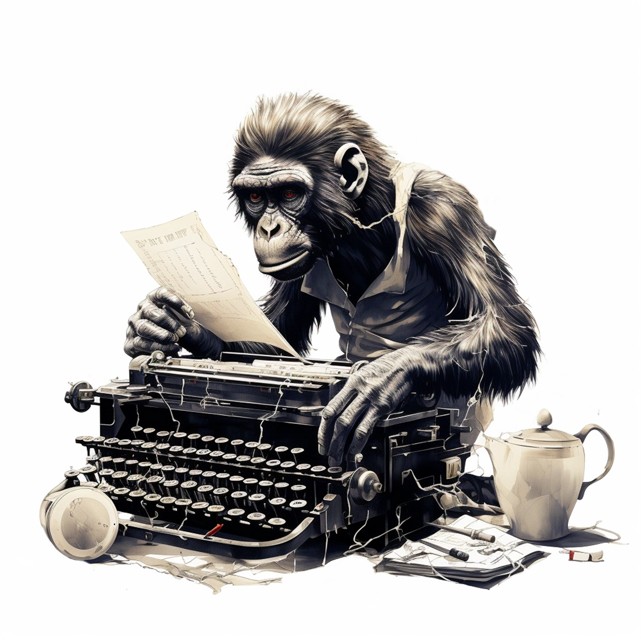
Method 2:
Type on a weighted keyboard

Slide 8
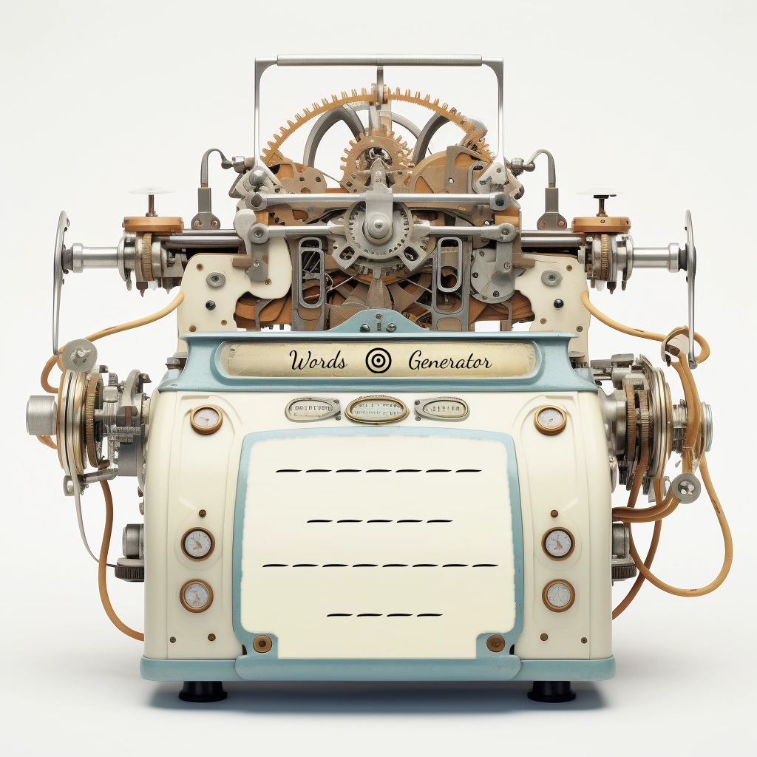
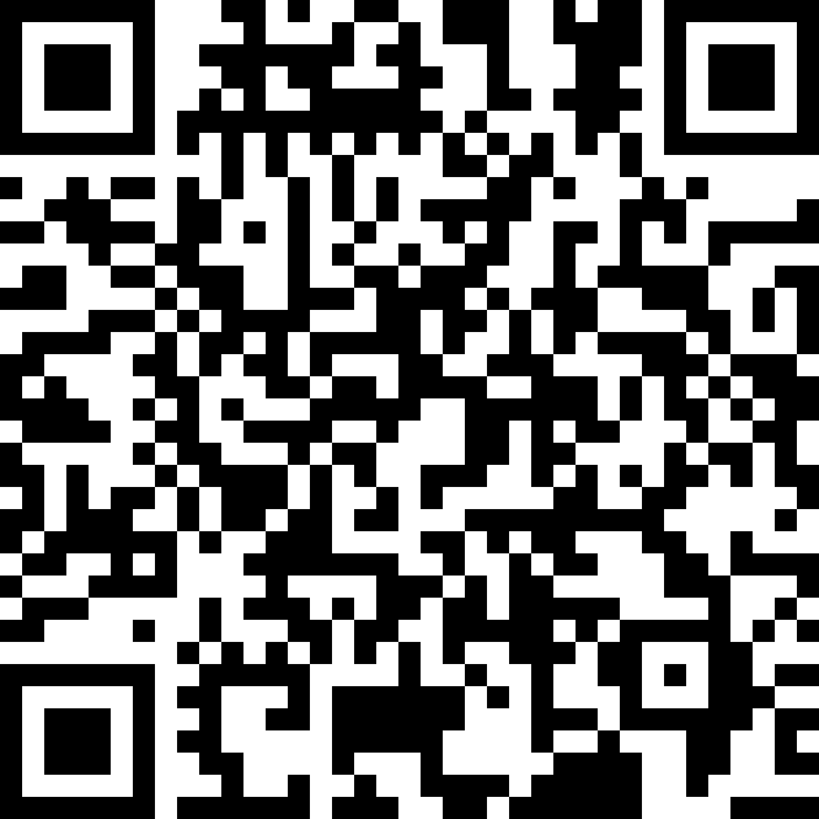
Words Generator Machine 2
https://pauldubois98.github.io/GenerativeAI/word_generator2.html

Slide 9
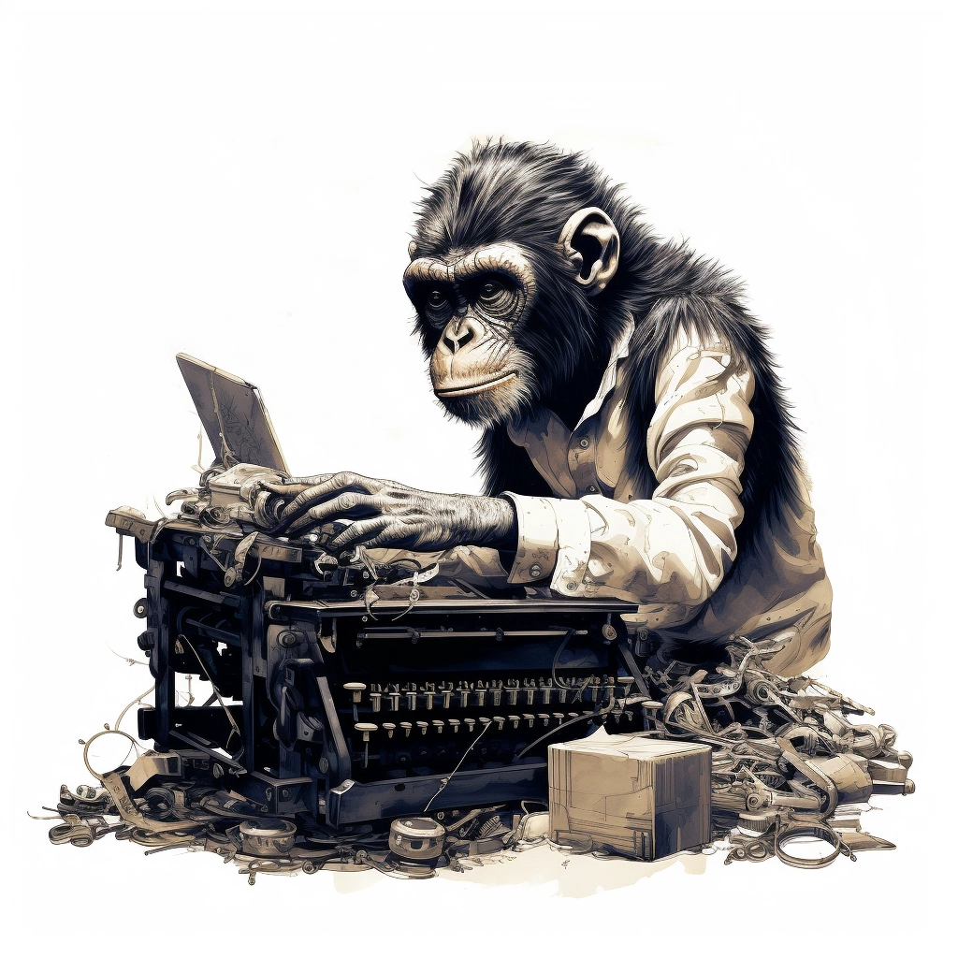
Method 3:
Dynamically weighted keyboard

Slide 10
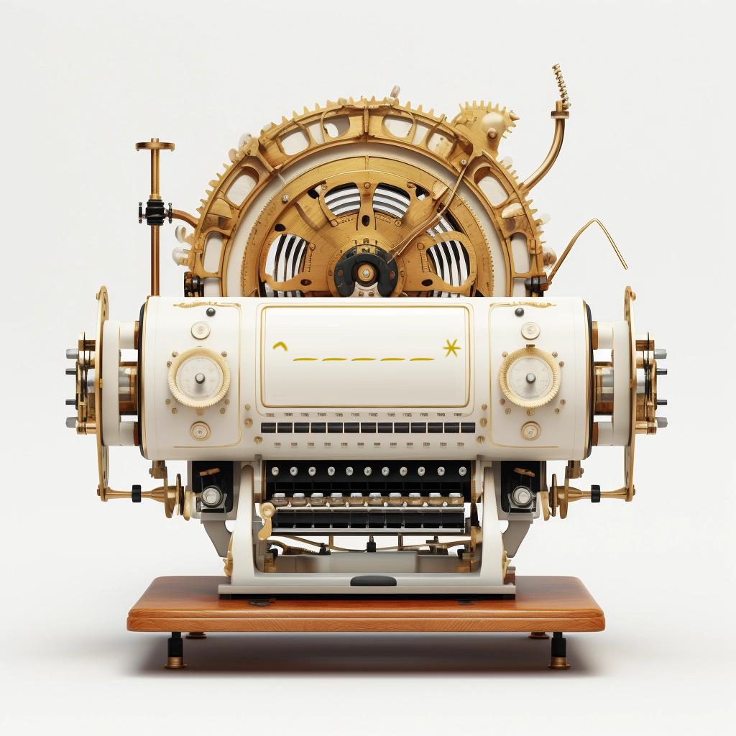
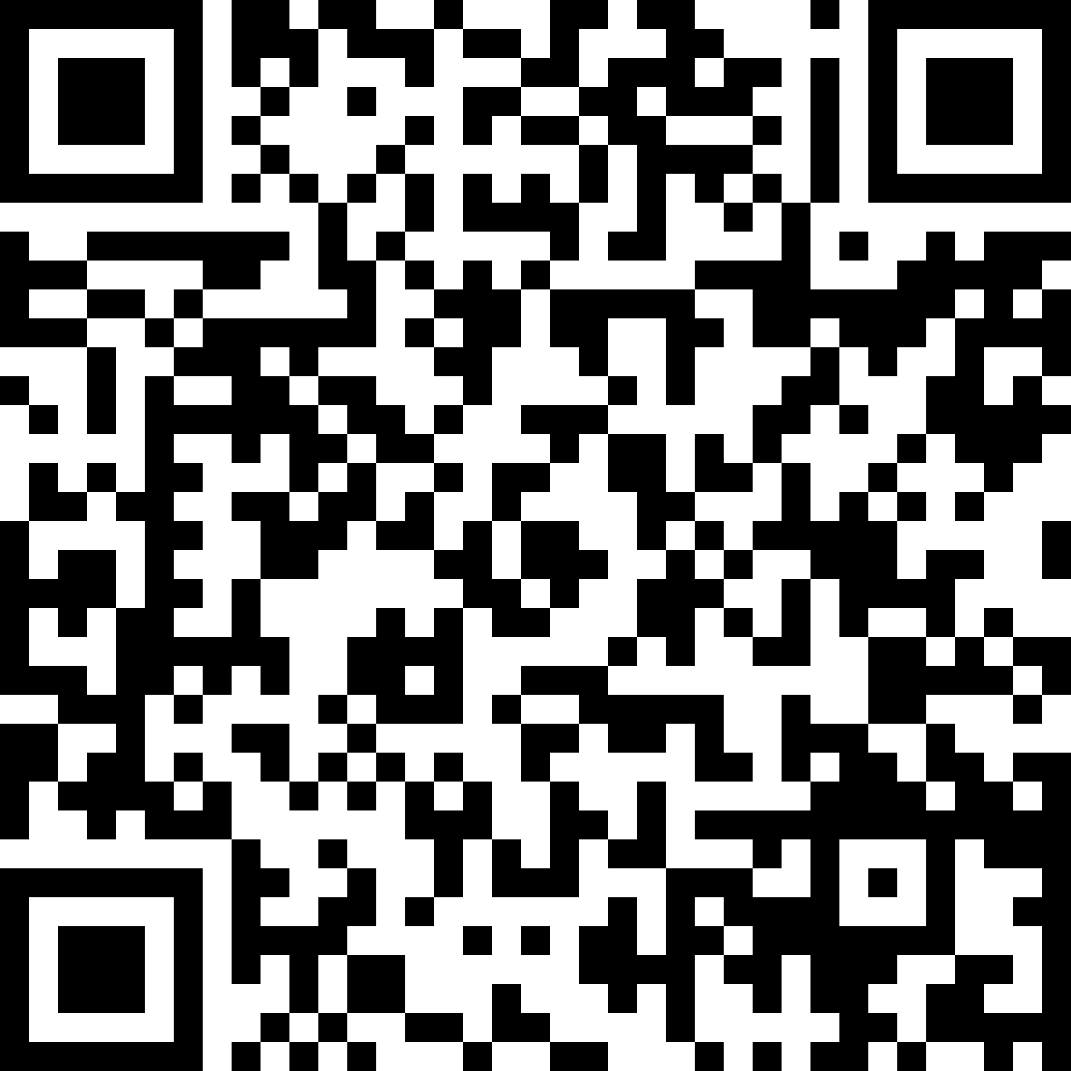
Words Generator Machine 3
https://pauldubois98.github.io/GenerativeAI/word_generator3.html

Slide 11
Predict letters

Slide 12
Generator vs Discriminator

Slide 13
Denoising

